Slide 1
Too / very
Basic 4 – Unit 10b

Slide 2
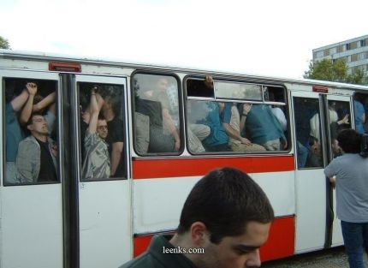
Are there a lot of people in the bus?
Yes, there are. The bus is too full.

Slide 3
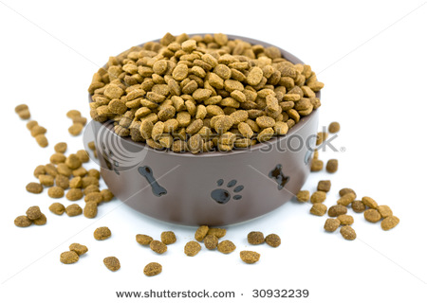
Is there are lot of food in the dog’s bowl?
Yes, there is. It is too full.

Slide 4
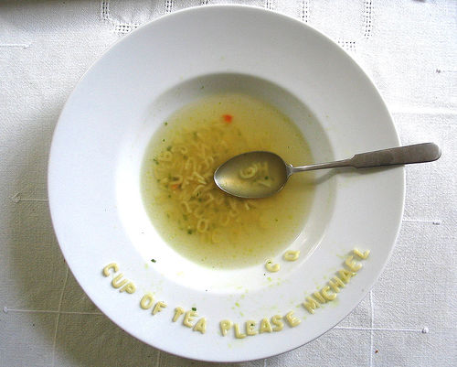
Is this enough soup?
No, it is too little.
No, there isn’t enough soup.

Slide 5
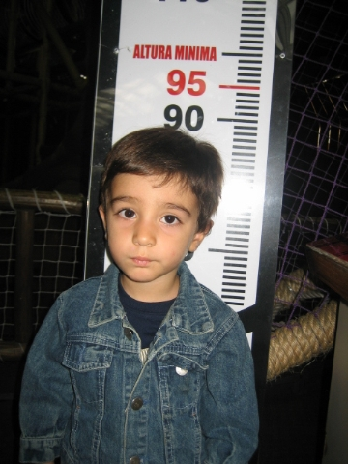
Is he tall enough to ride the rollercoaster?
No, he is not. He is too short for the roller coaster

Slide 6
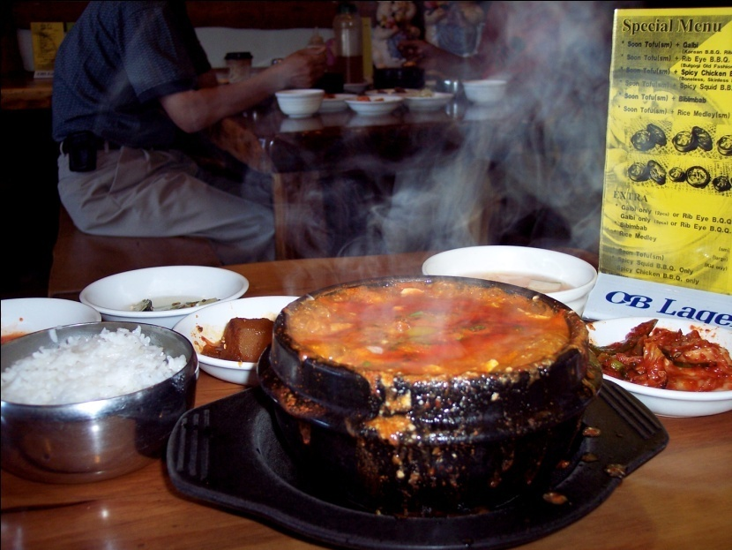
How is the soup?
The soup is too hot.

Slide 7
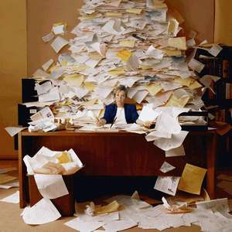
Can she go on vacation?
No, she can´t. She is too busy to go on vacation.

Slide 8
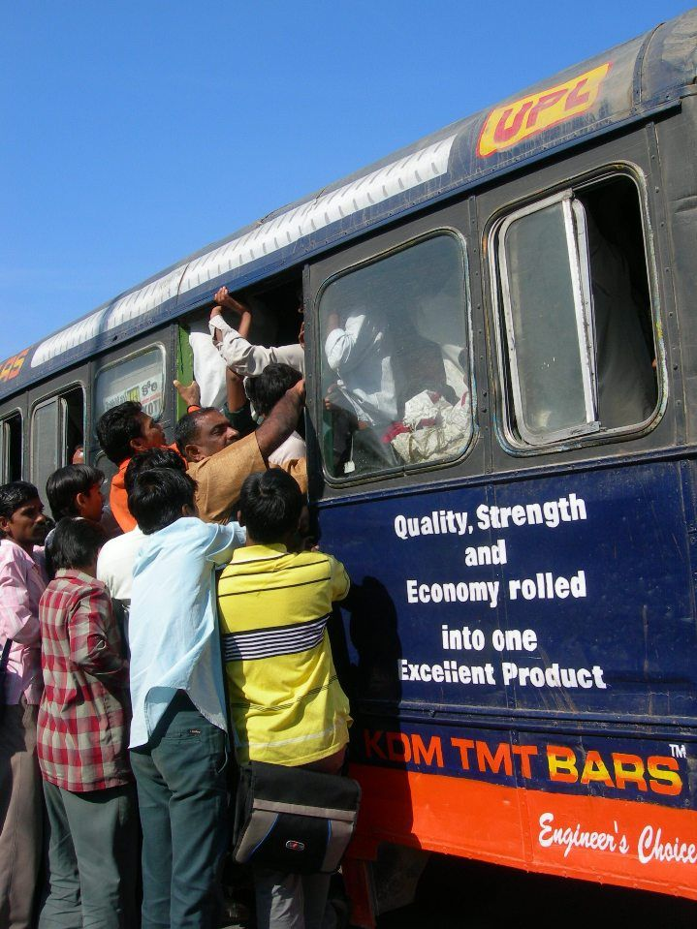

Slide 9
The backpack is (heavy) ______ to take .
You're (young) __________ to drive.
That sweater is big, it's (big) ____ for you.
This coffee is (strong) ________ for me.
The disco is (far) ___________ to walk. ☹
He's 16. He's (young) ______ to vote.
She's 14. She's (young) ____ to go to clubs.
I can't work today. It's (hot) ________.
I can't do this exercise because it's (difficult) ______.

Slide 10
Q1 - It is _____ . I can´t buy it.
very expensive too expensive
Q2 - It's ___ to read; but I think I understand the important ideas.
very difficult too difficult
Q3 - They are _____ , so they can´t be part of the basketball team.
too short very short
Q4 – The dog is _____ for that house. We need to buy a new one.
too big very big
Q5 – My apartment is ____ to buy more furniture. I need more space.
too small very big
Q6 – The exam is ____ . I don´t know the answers.
too difficult very difficult

